Slide 1

Bloomberg Trading Challenge
Provided with stocks related data for several different firms
Motivation
Implementing 5 investment strategies to which Bloomberg stock to invest in and how much
Image source: https://www.istockphoto.com/de/search/2/image?mediatype=illustration&phrase=black+and+white+coins
Notes:
Intro - Anaahita

Slide 2
Challenge Overview
Distinguished annual investment competition attracting international students globally for more than 20 years.
The challenge takes part as per New York trading times
Provides hands-on experience with real-world investing using virtual funds
Exclusive use of the Bloomberg Terminal in the competition.
Provides real-time financial data and analytics for trading strategies.
Equips students with essential skills in financial analysis and decision-making.
1
Notes:
Mayank

Slide 3
Structure of the Challenge
Teams of 3-5 students, led by a faculty advisor from University having a dedicated Bloomberg terminal for educational purposes.
Registration period opens several weeks before the competition begins.
The Challenge begins on 7th October 9AM (UTC-5)
Teams enter their starting positions by 11 October,2024 with virtual funds of 1 Million USD.
All trading activities are done exclusively through the Bloomberg Terminal.
Performance evaluated based on Relative P/L in comparison to Bloomberg's World Large, Mid & Small Cap Price Return Index (WLS).
Challenge ended on 15th Nov,2024.
Team with highest time-weighted relative return wins.
2

Slide 4
The Rules of the Challenge
All trading done exclusively via Bloomberg Terminal
Trades to be put only using the Captain's credentials
Trades through TMSG portal only
Official communication via MSG functionality of Bloomberg Terminal
Only equities listed in WLS index could be chosen
Only long trades allowed; no short selling was allowed
No leverage was given; ETFs not allowed
No single position should be greater than 20% of notional amount
3
Notes:
Mayank

Slide 5
Motivation for the Challenge
Gain experience in trading
Hone analytical abilities
Refine teamwork and communication skills
Improve creativity skills
4
Notes:
Motivation - Anaahita

Slide 6
Limitations of the Challenge
Team formed short-notice
Timing of challenge - short
Prioritization of challenge over other academic responsibilities
No prior experience
Competition set New York time
5
Notes:
Limitations - Anaahita

Slide 7
MODERN PORTFOLIO THEORY
6

Slide 8
Highly Volatile
Not very Volatile
Provides better return over time
Provides lower return over time
Asset 1
Asset 2
Price
Price
Time
Time
7

Slide 9
















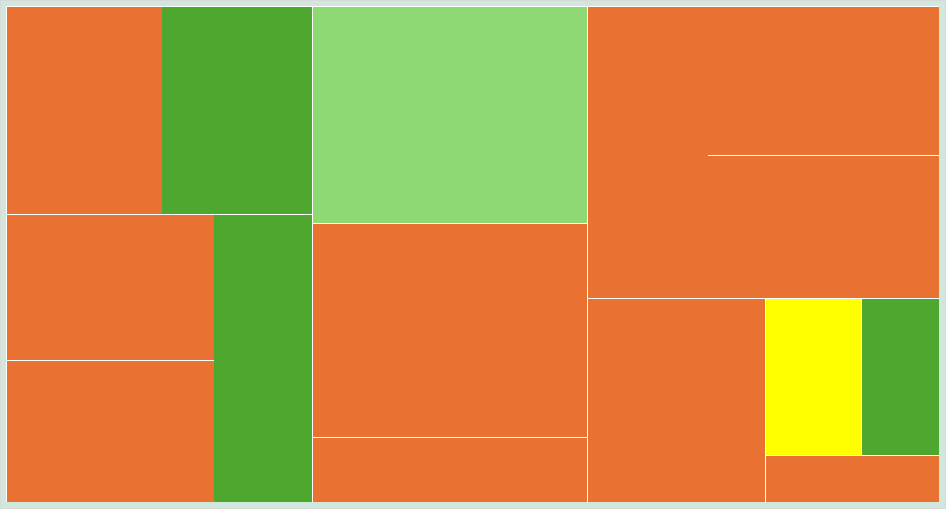
Greater Expected Returns
Less Volatility
8

Slide 10
Target of the Portfolio
The portfolio aims to:
Minimise Risk under a fixed amount of Expected Return.
or
Sharpe Ratio
Maximise Expected return under a fixed amount of Risk.
Sp = E(R_{p}) − R_{f}
or
σ_{p}
Maximise the ratio of Expected Return to the Risk undertaken.
9

Slide 11
A
B
D
F
C
E
A
Price
Returns
Return on t₁
R₁
R₁
R₁
R₁
R₁
t_{o}
P_{o}
Return on t₂
R₁
R₂
R₂
R₂
R₂
₋
R₁
Return on t₃
R₃
R₃
R₃
R₃
R₃
t₁
P₁
P₁
Return on t₄
R₄
R₄
R₄
R₄
R₄
R₄
₋
R₂
Return on t₅
R₅
R₅
R₅
R₅
R₅
R₅
t₂
P₂
Return on t₆
R₆
R₆
R₆
R₆
R₆
R₆
R₃
10

Slide 12
Expected Daily Return
Standard Deviation
E[R]_{a}
=
R₁ + R₂ + R₃ + R₄ + R₅ + R₆ +....+R_{n}
n
²
( )²
R_{n} -
σ
=
Variance
=
Σ
Measures the deviation of returns of asset from the mean return
N-1
Riskiness of the Asset
11

Slide 13
Securitization against Market Behavior
To protect the entire portfolio of the standard ups and downs of the market, the assets can be hedged against each other, such that the constituents’ return movements can be balanced out in case of failure of a few investments
This behavior can be studied and securitized by calculating the effects of price movements of single asset on other assets.
Balanced by Positive movement in Asset B
Failure of Investment in Asset A
Correlation
12

Slide 14
This relation between return movements can be calculated by calculating the Covariance
Price
Asset 2
Asset 1
Time
13

Slide 15
A
A
B
Returns
Price
Return on t₁
R₁
t_{o}
P_{o}
Return on t₂
R₁
₋
R₁
Return on t₃
R₃
t₁
P₁
P₁
Return on t₄
R₄
R₄
₋
R₂
Return on t₅
R₅
R₅
t₂
P₂
Return on t₆
R₆
R₆
R₃
14

Slide 16
Covariance
cov_{a,b} = Σ(R_{a} – E(R_{a}))(R_{b} – E(R_{b}))
N-1
>0 : Positively Correlated
<0 : Negatively Correlated
Correlation
ρ_{a,b} = (cov_{a,b})/σ_{a}. σ_{b}
-1>ρ>0 : Negatively Correlated
0<ρ<+1 : Positively Correlated
15

Slide 17
Correlation Matrix
A
B
C
D
E
F
A
1
ρ_{ab}
ρ_{ac}
ρ_{ad}
ρ_{ae}
ρ_{af}
B
ρ_{ab}
1
ρ_{bc}
ρ_{bd}
ρ_{be}
ρ_{bf}
C
ρ_{ac}
ρ_{bc}
1
ρ_{cd}
ρ_{cf}
ρ_{ce}
D
ρ_{ad}
ρ_{bd}
ρ_{cd}
1
ρ_{de}
ρ_{df}
E
ρ_{ae}
1
ρ_{ef}
ρ_{be}
ρ_{ce}
ρ_{de}
F
ρ_{af}
1
ρ_{bf}
ρ_{cf}
ρ_{df}
ρ_{ef}
16

Slide 18
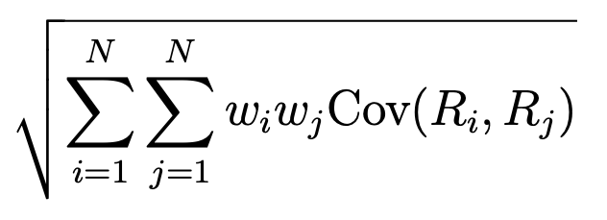
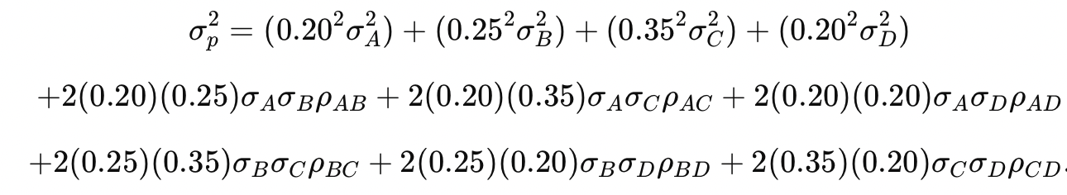
Standard Deviation of the Entire Portfolio
A(20%)
B(25%)
C(35%)
D(20%)
σ
=
p
17

Slide 19
To make the Efficient Portfolio
Dictated by the Sharpe Ratio
Sp = E(R_{p}) − R_{f}
σ_{p}
E(Rp): Expected Return of the portfolio: Σ[(w_{i})[E(R_{i})]]
R_{f} : Risk-Free Rate of Return
σp: Standard Deviation of the Entire Portfolio
18

Slide 20
Optimization Problem
Primary Objective: Maximize the Sharpe Ratio
Conditions
Stock 1
Stock 7
Stock 4
Expected Return
Stock 2
CAPITAL
Sector 1
Sector 2
Sector 3
Stock 5
Stock 8
Stock 3
Stock 6
Stock 9
Standard Deviation
19

Slide 21
Our Portfolio
36 Stocks of the 120 stocks considered
7 out of the12 Sectors considered
VST US
PEG US
AEP US
CEG US
DUK US
SO US
TMUS US
T US
NFLX US
VZ US
GOOG US
META US
ADP US
LMT US
UBER US
RTX US
GE US
PGR US
AXP US
GS US
JPM US
TTWO US
RBLX US
EA US
APP US
CL US
PM US
WMT US
COST US
CSCO US
CRM US
ORCL US
MSFT US
AVGO US
NVDA US
AAPL US
Technology
Consumer Discretionary
Energy
Consumer Staples
Electronic Sports
Financial
HealthCare
Industrials
Materials
IT
Telecommunication
Utilities
Expected Monthly Return
After Stock Diversification: 4.01%
Expected Monthly Return: 2.52%
Sharpe Ratio: : 1.83
Sharpe Ratio: : 3.29
20

Slide 22
Performance of the Portfolio
Investment Horizon: 24 Days
Absolute loss of $6,104.74
Gains relative to WLS Index stood at $3,895.05
21

Slide 23
EARNINGS CALL STRATEGY
22

Slide 24
Earnings Call Strategy
Positive Analyst Reports
Major Deals / Promising News
Price
Underperforms and Trails the Expectation
Beating Expectations
Positive Outlook for the next Quarter
Has a Negative Future Performance Prediction
Time
23

Slide 25
Stocks Chosen
Mastercard: Strong company numbers and great analyst predicions.
APA Corporation: Major Announcements for oil developments with Total Energies
Amazon: Following Analysis of the stock by Market Screener. Supported by upward momentum carrying sales numbers, strong predicted P/E ratio for 2025
Boeing: Recent events depicted stock comeback as worker strikes were on the verge of resolution, and the stock was heading into a strategy change.
24

Slide 26
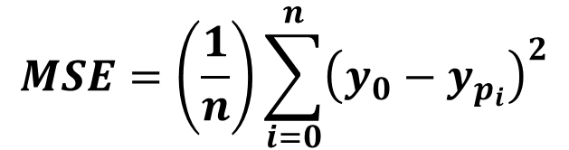
LINEAR REGRESSION
$$Y=β_{0}+β_{1}X_{1}+…⋅+ε$$
$$MSE=\left(\frac{1}{n}\right)\sum_{i=0}^{n}{{\left(y_{0}−y_{p_{i}}\right)}^{2}}$$
25
Notes:
Lin Regression - Anaahita

Slide 27
Firms Considered
Sherwin Williams
JP Morgan Chase CO
American Express CO
Progressive Corp
Freeport Memoran Inc
Berkshire Hathaway Inc Del
Mastercard Inc
Visa Inc
Lin Media
SP Global
Dow Inc
Corteva Inc
Newmont Goldcorp
Air Products Chemicals Inc
Nucor Corp
26
Notes:
Lin Regression – Anaahita
Diverse set firms

Slide 28
Steps Taken
1
Merging Data
Merging financial ratios and stocks related information
Preparing Data
Filing up empty spaces with previous values
Dropping NaN
Picked out independent variables to use
2
27
Notes:
Lin Regression - Anaahita

Slide 29
Steps Taken
4
Analysing Data
Splitting data intro train and test sets (0.25)
Standardising train and test values of x
Fitting Linear Regression model (x-train scaled and y-train)
Applying LR on x-test scaled values
Getting predicted y-train values as output
Comparing actual (y-train) with the predicted values
Calculating MSE to measure performance
3
Processing Data
Calculating 128 (2^7) combinations of Regression scenarios
Sorting them based on highest adjusted R^2 values
28
Notes:
Lin Regression - Anaahita

Slide 30
Basic setting
1
Independent Variables
P/E
Book/Market
Price/Cashflow
Return on Assets
Return on Equity
Total Debt/Equity
Price/Sales
2
Dependent Variable
Future return
3
Time Period
2007 – 2019
Between 2 global crisis
29
Notes:
Lin Regression – Anaahita

Slide 31
Justification for IV
P/E
P/E ratio calculates a company's stock price relative to its earnings per share, indicating whether the stock is overvalued or undervalued
Price/Book
P/B ratio measures market vs. book value: lower P/B suggests undervaluation and higher returns; higher P/B indicates overvaluation and lower returns
RoA
RoA measures a company's ability to generate profit from its assets, which can positively influence stock returns
30
Notes:
Lin Regression - Anaahita

Slide 32
Justification for IV
RoE
RoE measures how much profit a company gains relative to its shareholders' equity
Total Debt / Equity
D/E ratio captures the impact of a company's financial leverage on its risk profile and return potential
Price/Cashflow
This ratio measures how much investors are willing to pay for one unit of a company’s cash flow, showing its financial health and efficiency
Price/Sales
This ratio shows how much investors are willing to pay for each currency unit of a company’s sales, reflecting market expectations of future growth
31
Notes:
Lin Regression - Anaahita

Slide 33
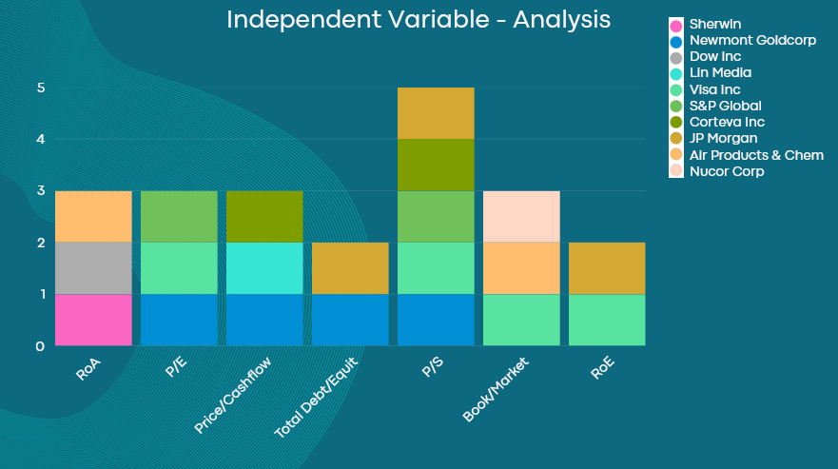

32
Notes:
Lin Regression - Anaahita

Slide 34
Setbacks of this strategy
Shortage of time
Market sentiment not considered
Exploration of other models
Method not always reliable
33
Notes:
Lin Regression - Anaahita

Slide 35
US PRESIDENTIAL ELECTIONS
34
Notes:
Lin Regression - Anaahita

Slide 36
US Presidential Elections based Investment Strategy
Historical Data and Market Trends:
Leveraged historical data and market trends associated with U.S. presidential elections.
Stock market shows distinct patterns around election cycles.
Pre-election and election years yield higher returns compared to post-election and midterm years.
Increased market volatility and changes in investor sentiment during election periods.
Sector Analysis:
Identified stocks and sectors that historically perform well during election years.
Analyzed past election cycles to identify industries benefiting from policy changes and government spending.
Focused on sectors favored by presidential candidates in debates and public statements.
35

Slide 37
Key sectors
Healthcare:
Significant volatility due to potential changes in healthcare policies and regulations.
Candidates’ stances on healthcare reform, pharmaceutical pricing, and insurance coverage impact market movements.
Technology:
Resilient and adaptive to changes in political leadership.
Technological innovation continues regardless of election outcome.
Policy proposals related to cryptocurrency, data privacy, cybersecurity, and technology infrastructure create short-term volatility.
Defense:
Tied to government spending and national security policies.
Positive performance with increased defense spending; negative impact with reduced military budgets.
36

Slide 38
Real Time analysis based on election News
Monitored key political events, debates between Harris and Trump, and exit polls to gauge market sentiment
Adjusted portfolio based on real-time analysis of market dynamics
Leveraged heightened market volatility for strategic trades
Took calculated risks and timed trades to capitalize on market fluctuations
37

Slide 39
Selected stocks and Reason for selection
Palantir Technologies:
Strong connections with government contracts, especially in defense and intelligence.
Focus on national security and increased defense spending aligns with Palantir’s business model.
Coinbase:
Benefits from Trump’s pro-cryptocurrency stance and approval of crypto ETFs.
Leading crypto exchange with significant revenue growth driven by transaction and subscription fees.
Tesla:
Innovation and technological advancements make it a resilient choice.
Support for manufacturing and job creation in the U.S. indirectly benefits Tesla’s American operations.
Elon Musk’s financial aid and open support for Trump influenced the decision.
38

Slide 40
Chevron:
Strong supporter of the energy sector, especially oil and gas.
Deregulation and backing fossil fuel production benefit companies like Chevron.
Ford Motors:
Supported American manufacturing and job creation in the U.S.
Policies focused on boosting domestic industries and reducing corporate taxes.
Trump Media:
Directly associated with Trump, ability to sway public opinion.
Anticipated short-term upside in investor sentiment if Trump won the presidency.
39

Slide 41
Active Trading (Predictive Indicators
40
Notes:
Lin Regression - Anaahita

Slide 42
Active Trading
Predictive Indicators
RSI
= 100 - 100
MACD Line
Upper Band
Upper Band
1 +RS
100
Price
Middle Band
Signal Line
Lower Band
Lower Band
0
MACD
RSI (Relative Strength Index)
Bollinger Bands
Stochastic Oscillator
Used for Trend Prediction
Used for Prediction of Sale Condition: Underbought/Overbought
Used for Prediction of Sale Condition: Underbought/Overbought
Used for Prediction of Sale Condition: Underbought/Overbought
41

Slide 43
Bloomberg Trading Challenge
Absolute Gain of $121,597
Gains relative to WLS Index stood at $111,263
Rank 1 in Germany
Rank 227 Globally
42

Slide 44
Learnings for Future Challenges
The leader of the challenge finished at $1,711,346
171% Gain
73% Gain for the 4th Position Team
The Gains were not uniformly distributed among the rankings.
43

Slide 45
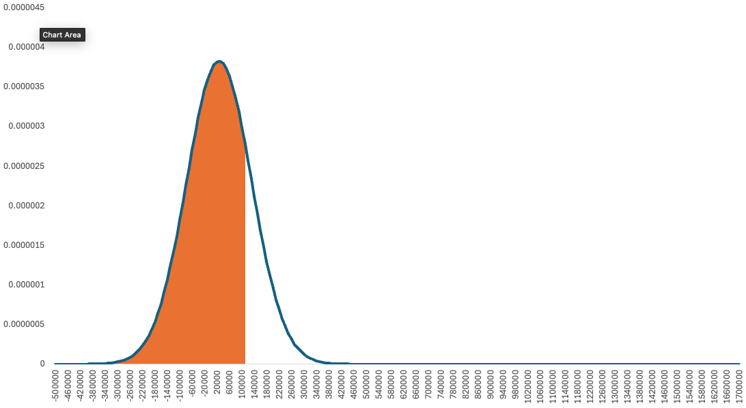
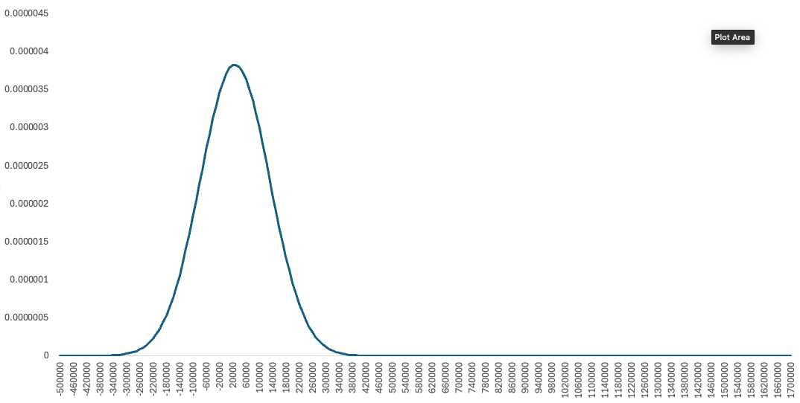
Learnings for Future Challenges
When plotting and studying the distribution of gains in the result
>900th
25th
4th
1st
44

Slide 46
Learnings for Future Challenges
While the traditional strategies to outperform the market worked,
We realized that bets exhibiting major gains on economic calendar and worldly events, such as geopolitical issues, and leadership events in major economic areas.
This leads us to believe that application based on expecting global events must be emphasized, while maintaining traditional strategies of trade.
45

Slide 47
We also realized some of the interesting areas where further study is required to perform better in trading stocks. Some of them are
U.S. Fed Tax Rates and their Effect
Dependency of Stocks on attached or related Commodities
Research into Ideal Time Horizon for Strategies based on Historic Data
Development of Frameworks to realize better Exit time for Trades
Better research into Earnings Call announcements and their effect
Research into Volatile Emerging Market Constituents
46

Slide 48
We would highly appreciate any feedback that we can be provided with, regarding challenges of such sort, as we would like to continue representing TUM Campus Heilbronn at such challenges.
47

Slide 49
THANK YOU
Presented by:
Anaahita Ghuman
Mayank Kalia
Kartik Sharma
48

